Slide 1
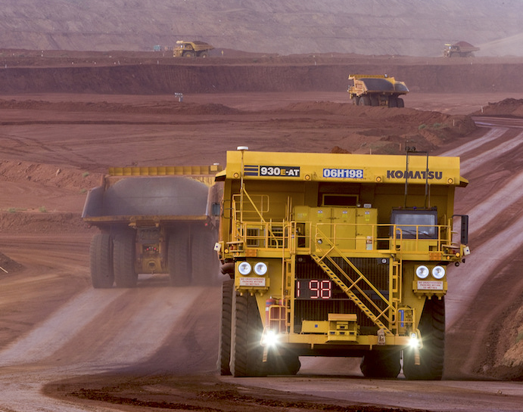
OPEN PIT MINING Supply Chain Analytics (DG) – Capstone Project
By Anjanjith Punnassery
Ankith Kumar Singh
Dheebiha Kalaiselvan

Slide 2
Agenda
Problem Statement
Objective
Key Findings
Recommendation
Methodology

Slide 3
Problem Statement & Objective
The open-pit mine is facing problems of inefficient production and is losing customers' trust as they are not able to meet their demands even though there has been no surge in demand.
The mine has operations such as the digging of ore and crushing of ore into a finer composition where this ore gets transported between the diggers and crushers using transportation trucks.
Need to build a smart live monitoring system and need to understand the key metrics explained by the client.

Slide 4
Equipment Availability
Total 136 equipment are working on the site. Truck cycle holds maximum number of equipment and it’s the only cycle containing autonomous equipment with only 2 manual one.
AuxMobile Cycle has high ratio of equipment under maintenance.

Slide 5
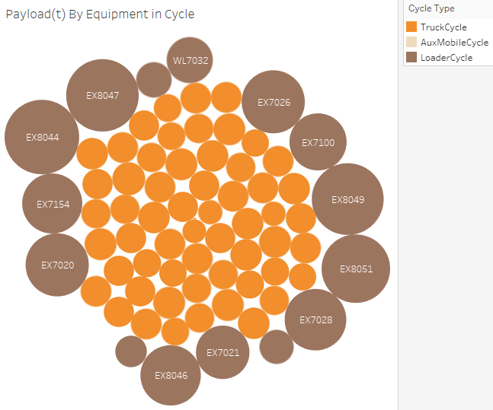
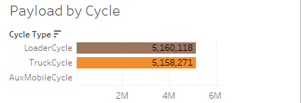
Production Rate
Equipment of AuxMobile cycle does not produce any load.
There is loss of 1847tons while carrying by truck cycle
EX8044 produces maximum load in loader cycle & DT5236 carries the maximum in truck cycle.

Slide 6
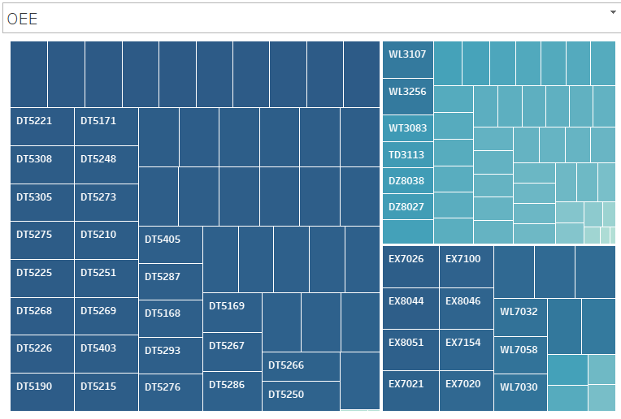
Efficiency OF Equipment
Truck class equipment has the maximum efficiency.
AuxMobile has the lowest efficiency

Slide 7
Recommendations
DT4123 & DT 4140 are the only two truck classes which are manual, and both are under maintenance. Replacing them with autonomous truck class will help to reduce the losses.
Queuing at source location is more even when wait time for truck at loading is 0. Need to take suitable action to check if actual wait time is 0 or trucks are more than needed.
Need to create maintenance schedule to reduce the defects in AuxMobile equipment.

Slide 8
Data Methodology
Dataset was loaded in python where the tables were cleaned and created the master tables for cycle, truck movement and delay tables.
Those three tables were loaded into MySQL with Username:root and Password: Anjanjith. After Loading we created a stored procedure for each table and OEE table.
Then with Tableau we connected the cleaned table to form suitable charts and derive key insights.
Video link here

